Slide 1
Spark
Fast, Interactive, Language-Integrated Cluster Computing
Dr. M. Zaharia. An Architecture for Fast and General Data Processing on Large Clusters (PhD Dissertation).
http://www.eecs.berkeley.edu/Pubs/TechRpts/2014/EECS-2014-12.pdf

Slide 2
Project Goals
Extend the MapReduce model to better support two common classes of analytics apps:
>> Iterative algorithms (machine learning, graph)
>> Interactive data mining
Enhance programmability:
>> Integrate into Scala programming language
>> Allow interactive use from Scala interpreter

Slide 3
Motivation
MapReduce greatly simplified “big data” analysis on large, unreliable clusters
But as soon as it got popular, users wanted more:
More complex, multi-stage applications (e.g. iterative machine learning & graph processing)
More interactive ad-hoc queries
Response: specialized frameworks for some of these apps (e.g. Pregel for graph processing)
Notes:
We all know that MapReduce and related models had huge adoption for data mining
But as soon as people started putting data into them, they wanted to do more

Slide 4
Motivation
Complex apps and interactive queries both need one thing that MapReduce lacks:
Efficient primitives for data sharing
In MapReduce, the only way to share data across jobs is stable storage ➔ slow!

Slide 5
Examples
HDFS read
HDFS write
HDFS read
HDFS write
iter. 1
iter. 2
. . .
Input
HDFS read
query 1
result 1
query 2
result 2
query 3
result 3
Input
. . .
Slow due to replication and disk I/O, but necessary for fault tolerance
Notes:
Emphasize that the overhead of replication and disk IO from HDFS comes from FT

Slide 6
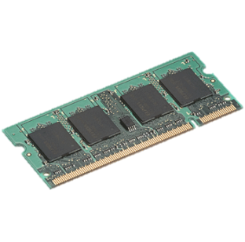
Goal: In-Memory Data Sharing
iter. 1
iter. 2
. . .
Input
query 1
one-time processing
query 2
query 3
Input
. . .
10-100× faster than network/disk, but how to get FT?

Slide 7
Challenge
How to design a distributed memory abstraction that is both fault-tolerant and efficient?

Slide 8
Challenge
Existing storage abstractions have interfaces based on fine-grained updates to mutable state
RAMCloud, databases, distributed mem, Piccolo
Requires replicating data or logs across nodes for fault tolerance
Costly for data-intensive apps
10-100x slower than memory write
Notes:
Say it’s expensive for data-intensive apps in particular
Data-intensive vs transactional -> show spectrum with update granularity and write throughput

Slide 9
Solution: Resilient Distributed Datasets (RDDs)
Restricted form of distributed shared memory
Immutable, partitioned collections of records
Can only be built through coarse-grained deterministic transformations (map, filter, join, …)
Efficient fault recovery using lineage
Log one operation to apply to many elements
Recompute lost partitions on failure
No cost if nothing fails
Notes:
Define RDDs more precisely here!

Slide 10
RDD Recovery
iter. 1
iter. 2
. . .
Input
query 1
one-time processing
query 2
query 3
Input
. . .

Slide 11
Generality of RDDs
Despite their restrictions, RDDs can express surprisingly many parallel algorithms
These naturally apply the same operation to multiple items
Unify many current programming models
Data flow models: MapReduce, Dryad, SQL, …
Specialized models for iterative apps: BSP (Pregel), iterative MapReduce (Haloop), bulk incremental, …
Support new apps that these models don’t
Notes:
Similarity to GFS/HDFS: large blocks, append only.

Slide 12
Outline
Introduction to Scala & functional programming
What is Spark
Resilient Distributed Datasets (RDDs)
Implementation
Demo
Conclusion

Slide 13
About Scala
High-level language for JVM
>> Object-oriented + Functional programming (FP)
Statically typed
>> Comparable in speed to Java
>> no need to write types due to type inference
Interoperates with Java
>> Can use any Java class, inherit from it, etc;
>> Can also call Scala code from Java

Slide 14
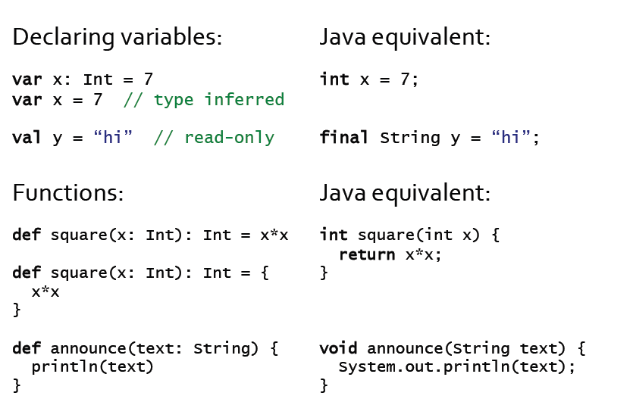

Quick Tour

Slide 15
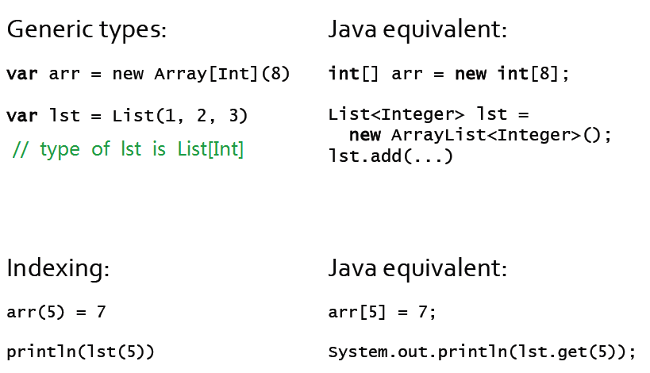
Quick Tour

Slide 16
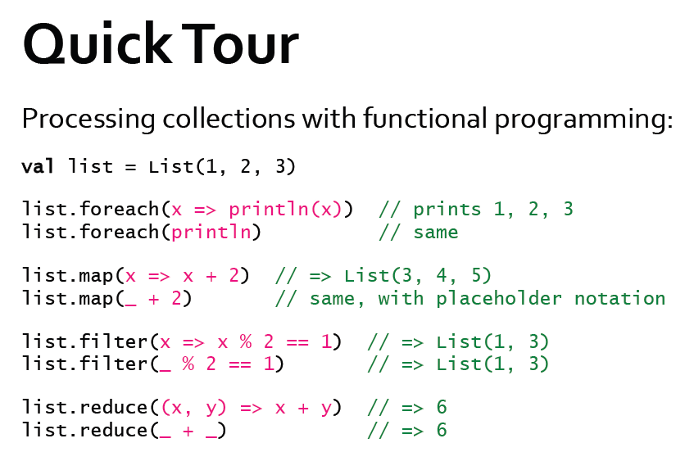

All of these leave the list unchanged (List is Immutable)

Slide 17
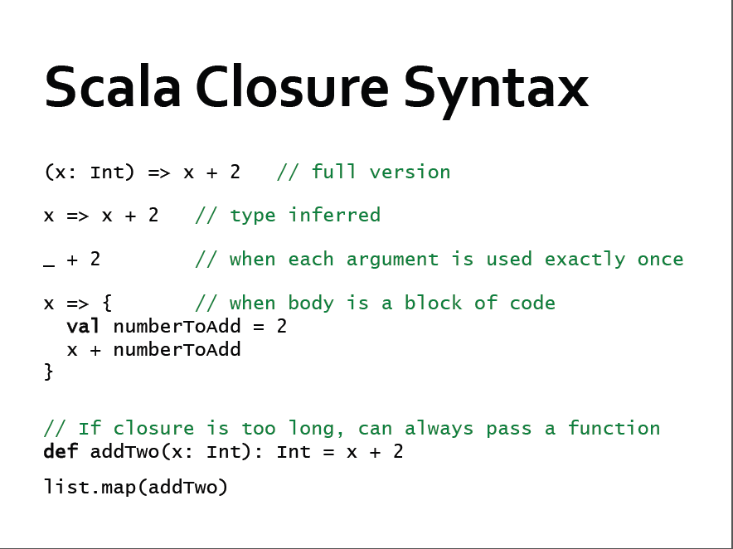


Slide 18
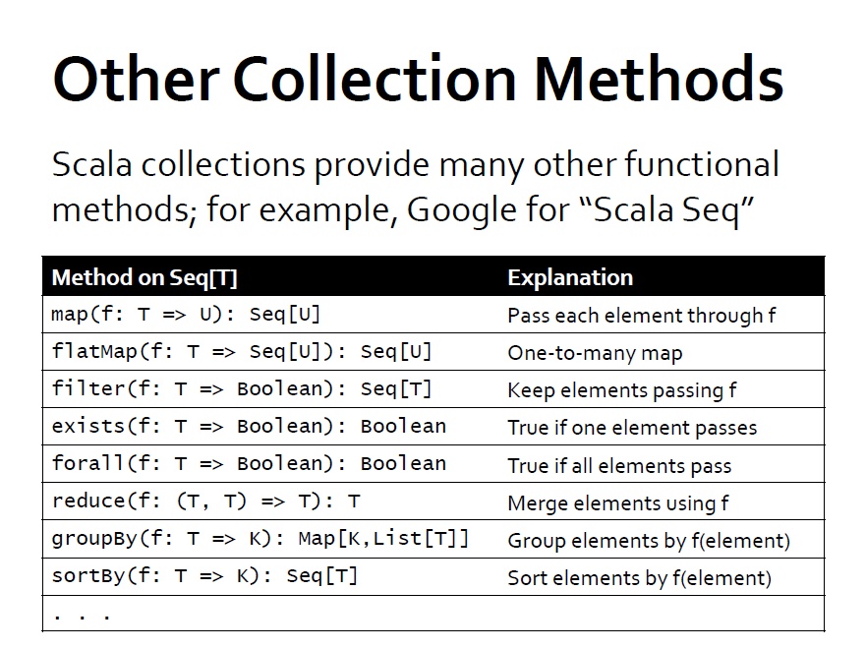

Slide 19
Outline
Introduction to Scala & functional programming
What is Spark
Resilient Distributed Datasets (RDDs)
Implementation
Demo
Conclusion

Slide 20
Spark Overview
Goal: work with distributed collections as you would with local ones
Concept: resilient distributed datasets (RDDs)
>> Immutable collections of objects spread across a cluster
>> Built through parallel transformations (map, filter, etc)
>> Automatically rebuilt on failure
>> Controllable persistence (e.g. caching in RAM) for reuse
>> Shared variables that can be used in parallel operations

Slide 21
Generality of RDDs
We conjecture that Spark’s combination of data flow with RDDs unifies many proposed cluster programming models
General data flow models: MapReduce, Dryad, SQL
Specialized models for stateful apps: Pregel (BSP), HaLoop (iterative MR), Continuous Bulk Processing
Instead of specialized APIs for one type of app, give user first-class control of distrib. datasets
Notes:
Key idea:

Slide 22
Outline
Introduction to Scala & functional programming
What is Spark
Resilient Distributed Datasets (RDDs)
Implementation
Demo
Conclusion

Slide 23
RDD Abstraction
An RDD is a read-only , partitioned collection of records
Can only be created by :
(1) Data in stable storage
(2) Other RDDs (transformation , lineage)
An RDD has enough information about how it was derived from other datasets(its lineage)
Users can control two aspects of RDDs:
1) Persistence (in RAM, reuse)
2) Partitioning (hash, range, [<k, v>])
Notes:
RDD可以根据关键字指定分区顺序，
目前支持hash分区和range分区。用户可以使用同一种hash来将两个RDD进行分区，这样便于以后的join操作。
RDD是静态类型对象，当然你也可以像定义其他对象一样来定义RDD，如RDD[Int]

Slide 24
RDDs in More Detail
An RDD is an immutable, partitioned, logical collection of records
Need not be materialized, but rather contains information to rebuild a dataset from stable storage
Partitioning can be based on a key in each record (using hash or range partitioning)
Built using bulk transformations on other RDDs
Can be cached for future reuse

Slide 25
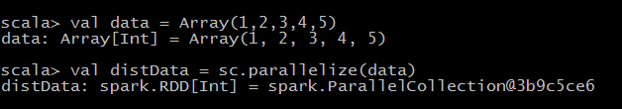
RDD Types: parallelized collections
By calling SparkContext’s parallelize method on an existing Scala collection (a Seq obj)
Once created, the distributed dataset can be operated on in parallel

Slide 26
RDD Types: Hadoop Datasets
Spark supports text files, SequenceFiles, and any other Hadoop inputFormat
val distFiles = sc.textFile(URI)
Other Hadoop inputFormat
val distFile = sc.hadoopRDD(URI)
Local path or hdfs://, s3n://, kfs://

Slide 27
RDD Operations
Transformations
>> create a new dataset from an existing one
Actions
>> Return a value to the driver program
Transformations are lazy, they don’t compute right away. Just remember the transformations applied to datasets(lineage). Only compute when an action require.

Slide 28
Spark Operations
Transformations (define a new RDD) | map filter sample groupByKey reduceByKey sortByKey | flatMap union join cogroup cross mapValues
Actions (return a result to driver program) | collect reduce count save lookupKey

Slide 29
Transformations
Transformations | Meaning
map(func) | Return a new distributed dataset formed by passing each element of the source through a function func
flatMap(func) | Return a new datasets formed by selecting those elements of the source on which func returns true
union(otherDateset) | Return a new dataset that contains the union of the elements in the source dataset and the argument
… | …

Slide 30
Actions
Actions | Meaning
reduce(func) | Aggregate the elements of the dataset using a function func
collect() | Return all the elements of the dataset as an array at the driver program
count() | Return the number of elements in dataset
first() | Return the first element of the dataset
saveAsTextFile(path) ….. | Write the elements of the dataset as text file (or set of text file) in a given dir in the local file system, HDFS or any other Hadoop-supported file system ……

Slide 31
Memory Management
Spark provides three options for persist RDDs:
(1) in-memory storage as deserialized Java Objs
>> fastest, JVM can access RDD natively
(2) in-memory storage as serialized data
>> space limited, choose another efficient representation, lower performance cost
(3) on-disk storage
>> RDD too large to keep in memory, and costly to recompute

Slide 32

Example: Log Mining
Load error messages from a log into memory, then interactively search for various patterns
Base RDD
Cache 1
lines = spark.textFile(“hdfs://...”)
errors = lines.filter(_.startsWith(“ERROR”))
messages = errors.map(_.split(‘\t’)(2))
cachedMsgs = messages.cache()
Transformed RDD
Worker
results
tasks
Block 1
Driver
Cached RDD
Parallel operation
cachedMsgs.filter(_.contains(“foo”)).count
cachedMsgs.filter(_.contains(“bar”)).count
Cache 2
Worker
. . .
Cache 3
Result: full-text search of Wikipedia in <1 sec (vs 20 sec for on-disk data)
Worker
Block 2
Block 3

Slide 33
RDD Fault Tolerance
RDDs maintain lineage information that can be used to reconstruct lost partitions
Ex:
cachedMsgs = textFile(...).filter(_.contains(“error”))
.map(_.split(‘\t’)(2))
.cache()
HdfsRDD
path: hdfs://…
FilteredRDD
func: contains(...)
MappedRDD
func: split(…)
CachedRDD

Slide 34
Fault Recovery
RDDs track the graph of transformations that built them (their lineage) to rebuild lost data
E.g.:
messages = textFile(...).filter(_.contains(“error”))
.map(_.split(‘\t’)(2))
HadoopRDD
FilteredRDD
MappedRDD
HadoopRDD
path = hdfs://…
FilteredRDD
func = _.contains(...)
MappedRDD
func = _.split(…)

Slide 35
Benefits of RDD Model
Consistency is easy due to immutability
Inexpensive fault tolerance (log lineage rather than replicating/checkpointing data)
Locality-aware scheduling of tasks on partitions
Despite being restricted, model seems applicable to a broad variety of applications

Slide 36
RDDs vs Distributed Shared Memory
Concern | RDDs | Distr. Shared Mem.
Reads | Fine-grained | Fine-grained
Writes | Bulk transformations | Fine-grained
Consistency | Trivial (immutable) | Up to app / runtime
Fault recovery | Fine-grained and low-overhead using lineage | Requires checkpoints and program rollback
Straggler mitigation | Possible using speculative execution | Difficult
Work placement | Automatic based on data locality | Up to app (but runtime aims for transparency)

Slide 37
Representing RDDs
Challenge: choosing a representation for RDDs that can track lineage across transformations
Each RDD include:
1) A set of partitions(atomic pieces of datasets)
2) A set of dependencies on parent RDDs
3) A function for computing the dataset based
its parents
4) Metadata about its partitioning scheme
5) Data placement

Slide 38
Interface used to represent RDDs
Operation | Meaning
partitons() | Return s list of partition objects
preferredLocations(p) | List nodes where partition p can be accessed faster due to data locality
dependencies() | Return a list of dependencies
iterator(p, parenetIters) | Compute the elements of partition p given iterators for its parent partitions
partitioner() | Return metadata specifying whether the RDD is hash/range partitioned
Notes:
设计接口的一个关键问题就是，如何表示RDD之间的依赖。我们发现RDD之间的依赖关系可以分为两类，即：（1）窄依赖（narrow dependencies）：子RDD的每个分区依赖于常数个父分区（即与数据规模无关）；（2）宽依赖（wide dependencies）：子RDD的每个分区依赖于所有父RDD分区。例如，map产生窄依赖，而join则是宽依赖（除非父RDD被哈希分区）。

Slide 39
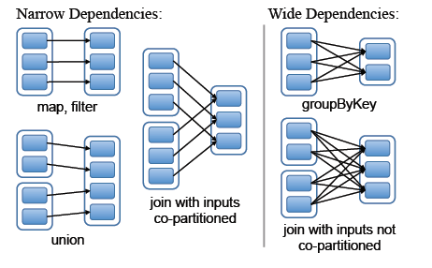
RDD Dependencies
Each box is an RDD, with partitions shown as shaded rectangles
Notes:
窄依赖允许一个集群节点以流水线的方式计算所以父分区。
宽依赖类似于MR的shuffle过程。

Slide 40
Outline
Introduction to Scala & functional programming
What is Spark
Resilient Distributed Datasets (RDDs)
Implementation
Demo
Conclusion

Slide 41
Implementation
Implement Spark in about 14,000 lines of Scala
Sketch three of the technically parts of the system:
>> Job Scheduler
>> Fault Tolerance
>> Memory Management

Slide 42
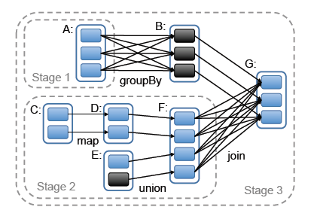
Job Scheduler
Build a DAG according to RDD’s lineage graph
Action
Action
Action
partition
cached partition
RDD
Notes:
调度器根据目标RDD的血统关系图（lineage graph）创建一个由stage构成的无回路有向图（DAG）。每个stage内部尽可能多地包含一组具有窄依赖关系的转换，并将它们流水线并行化（pipeline）。stage的边界有两种情况：一是宽依赖上的混排（shuffle）操作；二是已缓存分区，它可以缩短父RDD的计算过程。
调度器根据数据存放的位置分配任务，以最小化通信开销。如果某个任务需要处理一个已缓存分区，则直接将任务分配给拥有这个分区的节点。否则，如果需要处理的分区位于多个可能的位置（例如，由HDFS的数据存放位置决定），则将任务分配给这一组节点。对于宽依赖（例如需要混排的依赖），目前的实现方式是，在拥有父分区的节点上将中间结果物化（materialize），简化容错处理，这跟MapReduce中物化map输出很像。
如果某个任务失效，只要stage中的父RDD分区可用，则只需在另一个节点上重新运行这个任务即可。如果某些stage不可用（例如，混排时某个map输出丢失），则需要重新提交这个stage中的所有任务来计算丢失的分区。
最后，lookup行为允许用户从一个哈希或范围分区的RDD上，根据关键字读取一个数据元素。这里有一个设计问题。Driver程序调用lookup时，只需要使用当前调度器接口计算关键字所在的那个分区。当然任务也可以在集群上调用lookup，这时可以将RDD视为一个大的分布式哈希表。这种情况下，任务和被查询的RDD之间的并没有明确的依赖关系（因为worker执行的是lookup），如果所有节点上都没有相应的缓存分区，那么任务需要告诉调度器计算哪些RDD来完成查找操作。

Slide 43
Task Scheduler
Dryad-like DAGs
Pipelines functions within a stage
Locality & data reuse aware
Partitioning-aware to avoid shuffles
A:
B:
G:
Stage 1
groupBy
C:
D:
F:
map
E:
join
Stage 2
union
Stage 3
= cached data partition
Notes:
NOT a modified version of Hadoop

Slide 44
RDDs vs. Distributed Shared Memory
Aspect | RDDs | DSM
Reads | Coarse- or fine-grained | Fine-grained
Writes | Coarse-grained | Fine-grained
Consistency | Trivial(immutable) | Up to app / runtime
Fault recovery | Fine-grained and low-overhead using lineage | Requires checkpoints and program rollback
Straggler mitigation | Possible using backup tasks | Difficult
Work placement | Automatic based on data locality | Up to app (runtimes aim for transparency)
Behavior if not enough RAM | Similar to existing data flow systems | Poor performance(swapping ?)
Notes:
DSM中，app可以向全局地址空间的任意文职进行读写操作。这样容错性实现就很困难
RDD限制用户执行批量写操作，有利于容错。不需要checkpointing开销，因为有Lineage来记录信息。
RDD基于MapReduce实现的，所以可以通过备份处理落后的任务。
RDD批量扫描数据存放位置，选择最近的适合数据进行计算。位置感知性

Slide 45
Outline
Introduction to Scala & functional programming
What is Spark
Resilient Distributed Datasets (RDDs)
Main technically parts of Spark
Demo
Conclusion

Slide 46
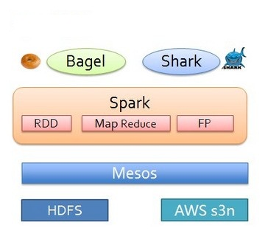
Spark framework
Spark + Hive
Spark + Pregel
Notes:
Mesos 分布式资源统一管理平台，现在有很多的分布式计算框架用于特定的计算，如Storm，Pregel，MR在线，MR离线等等，他们需要一个统一的资源管理平台来进行资源之间的合理调度，来提高资源利用率和程序的运行效率。
目前主流的这类平台还有MRv2,即YARN。Facebook自主研发了一个开源计算框架，类似于YARN。

Slide 47
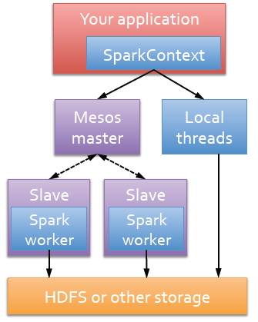
Run Spark
Spark runs as a library in your program
(1 instance per app)
Runs tasks locally or on Mesos
>> new SparkContext ( masterUrl, jobname, [sparkhome], [jars] )
>> MASTER=local[n] ./spark-shell
>> MASTER=HOST:PORT ./spark-shell

Slide 48
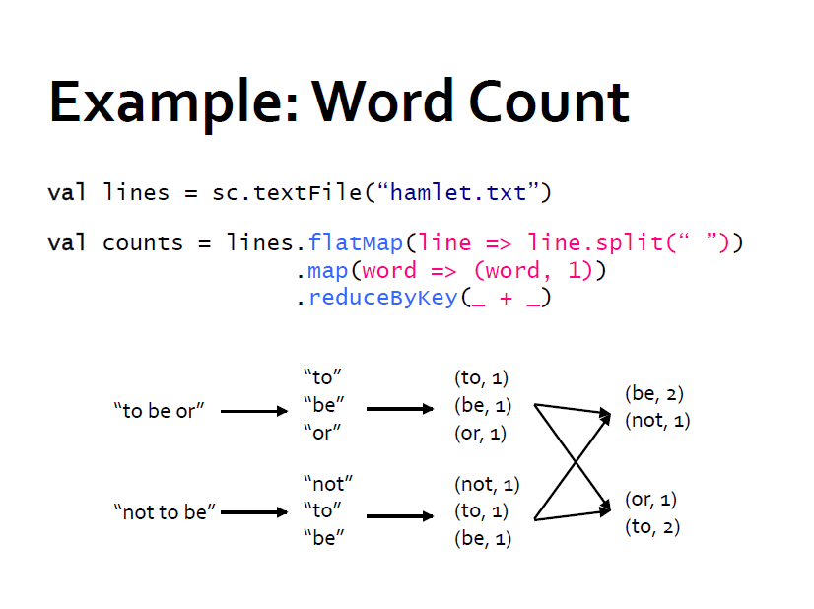

Slide 49
Example: Logistic Regression
Goal: find best line separating two sets of points
random initial line
+
+
+
+
+
+
–
+
+
–
–
–
+
+
–
–
–
–
–
–
target
Notes:
Note that dataset is reused on each gradient computation

Slide 50
Logistic Regression Code
val data = spark.textFile(...).map(readPoint).cache()
var w = Vector.random(D)
for (i <- 1 to ITERATIONS) {
val gradient = data.map(p =>
(1 / (1 + exp(-p.y*(w dot p.x))) - 1) * p.y * p.x
).reduce(_ + _)
w -= gradient
}
println("Final w: " + w)

Slide 51
Logistic Regression Performance
127 s / iteration
first iteration 174 s
further iterations 6 s
Notes:
This is for a 29 GB dataset on 20 EC2 m1.xlarge machines (4 cores each)

Slide 52
Example: MapReduce
MapReduce data flow can be expressed using RDD transformations
res = data.flatMap(rec => myMapFunc(rec))
.groupByKey()
.map((key, vals) => myReduceFunc(key, vals))
Or with combiners:
res = data.flatMap(rec => myMapFunc(rec))
.reduceByKey(myCombiner)
.map((key, val) => myReduceFunc(key, val))

Slide 53
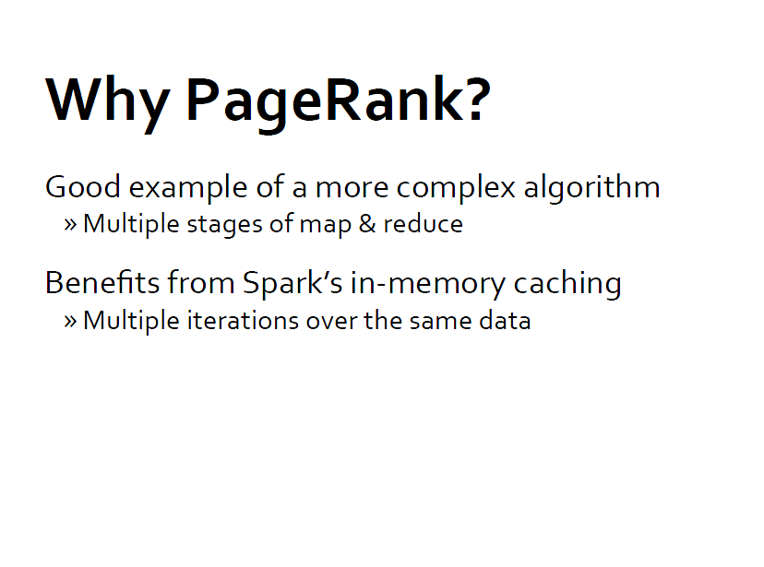
PageRank

Slide 54
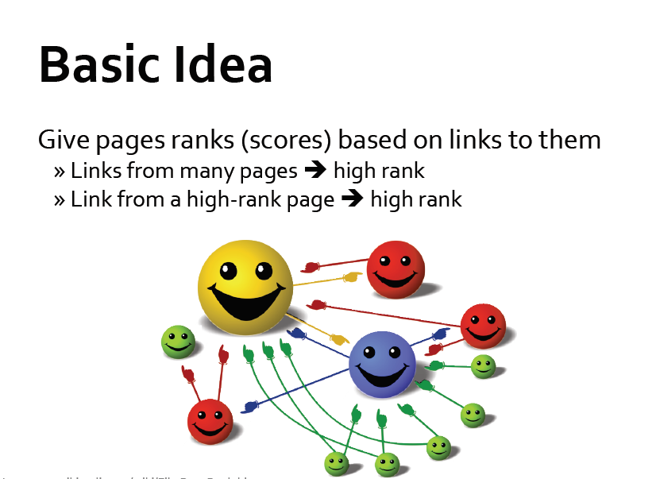

Slide 55
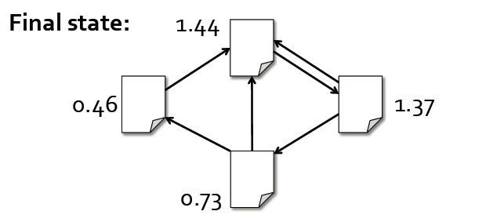
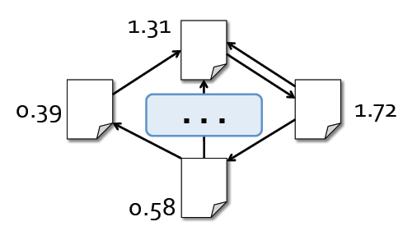
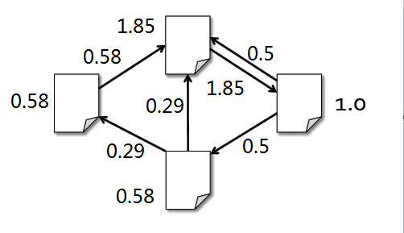
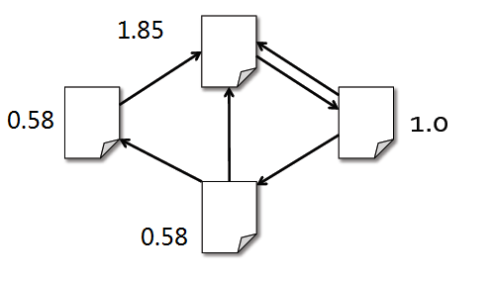
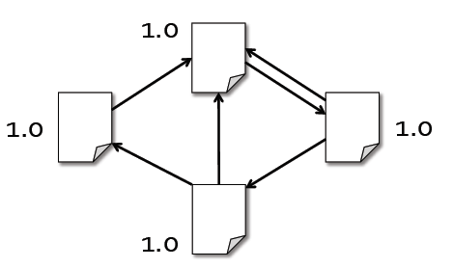

Algorithm
1.Start each page at a rank of 1
2.On each iteration, have page p contribute ${rank}_{p}/|{neighbors}_{p}|$ to its neighbors
3. Set each page’s rank to 0.15 + 0.85 * contribs
0.5
1
1
0.5
0.5
0.5

Slide 56
